Slide 1
Natural Language and Speech Processing
Lecture 10: Recurrent Neural Networks for Modeling Language
Tanel Alumäe

Slide 2
NLP and Sequential Data
NLP is full of sequential data
Words in sentences
Characters is words
Sentences in document
...

Slide 3
Long-distance dependencies
Agreement in number, gender, etc
He does not have very much confidence in himself.
She does not have very much confidence in herself.
Selectional preference
The reign has lasted as long as the life of the queen.
The rain has lasted as long as the life of the clouds.

Slide 4
Long-distance dependencies, II
What does „it” refer to?
The trophy would not fit in the brown suitcase because it was too big. Trophy
The trophy would not fit in the brown suitcase because it was too small. Suitcase

Slide 5
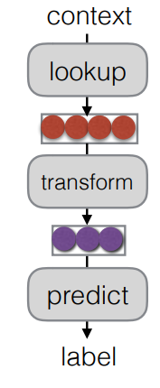
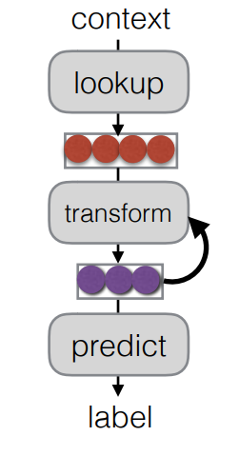
Recurrent neural networks
Feed-forward neural network
Recurrent neural network

Slide 6
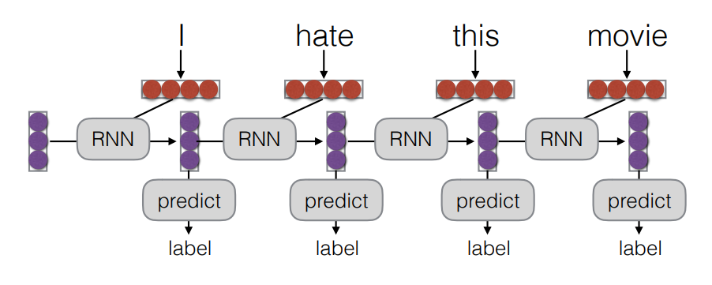
Unrolling a neural network in time
Processing a sequence (e.g. a sentence) with a neural network
The current output of RNN depends on the hidden state at the prior state (a vector) and current input (another vector)
In NLP terms, the prediction for the current output word depends on the current input word and the hidden layer output of the previous word
This is the reason RNNs are considered to have memory

Slide 7
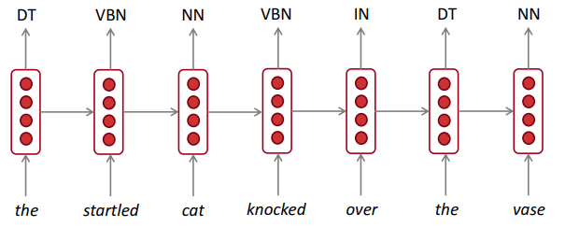
RNNs for word labeling
RNNs are very flexible and can be customized for different tasks
Below: RNN for word labeling
i.e., classify every element of a sequence

Slide 8
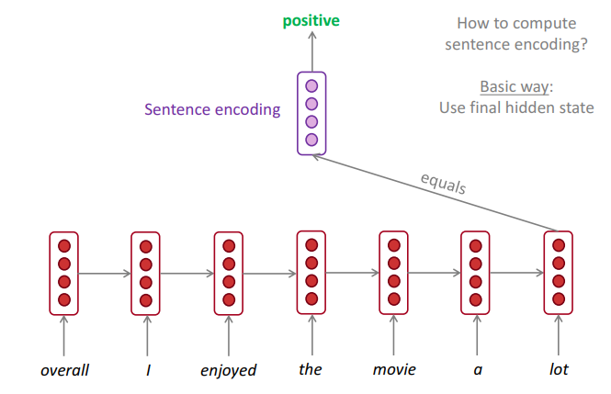
RNN for sequence labeling
RNNs can be used for labeling the whole sequence
E.g., for classifying sentences/documents
Simplest: just use the final hidden state for classification
The RNN should learn to propagate the most important information through the sentence

Slide 9
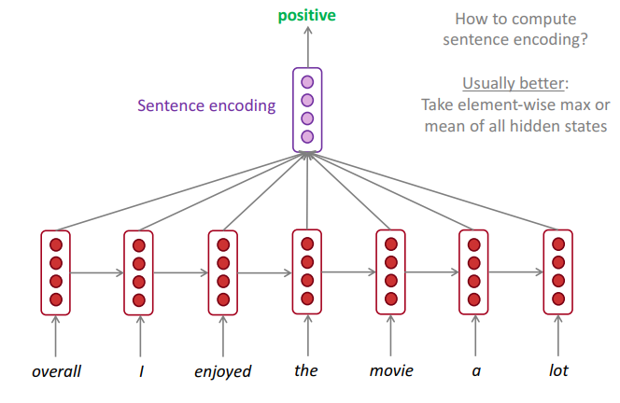
RNN for sequence labeling
Alternative: average or max the hidden states over the whole sequence
Even better: attention mechanism – learn a function that weights the hidden states appropriately (e.g., downweight the function words)

Slide 10
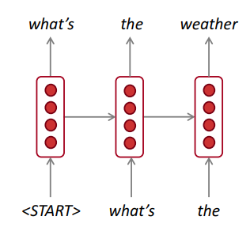
RNN for generating text
RNN can be used for generaing text
Start with some random initial state, use a pseudo-word <START> as the initial input
Generate a word (or character)
Sample it from the output distribution (sample = pick a random word, with the given probability)
Feed it back to the same RNN, and generate another word

Slide 11
RNN text generation samples I
Shakespeare: KING LEAR: O, if you were a feeble sight, the courtesy of your law, Your sight and several breath, will wear the gods With his heads, and my hands are wonder'd at the deeds, So drop upon your lordship's head, and your opinion Shall be against your honour.
Wikipedia: Naturalism and decision for the majority of Arab countries' capitalide was grounded by the Irish language by [[John Clair]], [[An Imperial Japanese Revolt]], associated with Guangzham's sovereignty. His generals were the powerful ruler of the Portugal in the [[Protestant Immineners]], which could be said to be directly in Cantonese Communication, which followed a ceremony and set inspired prison, training.

Slide 12
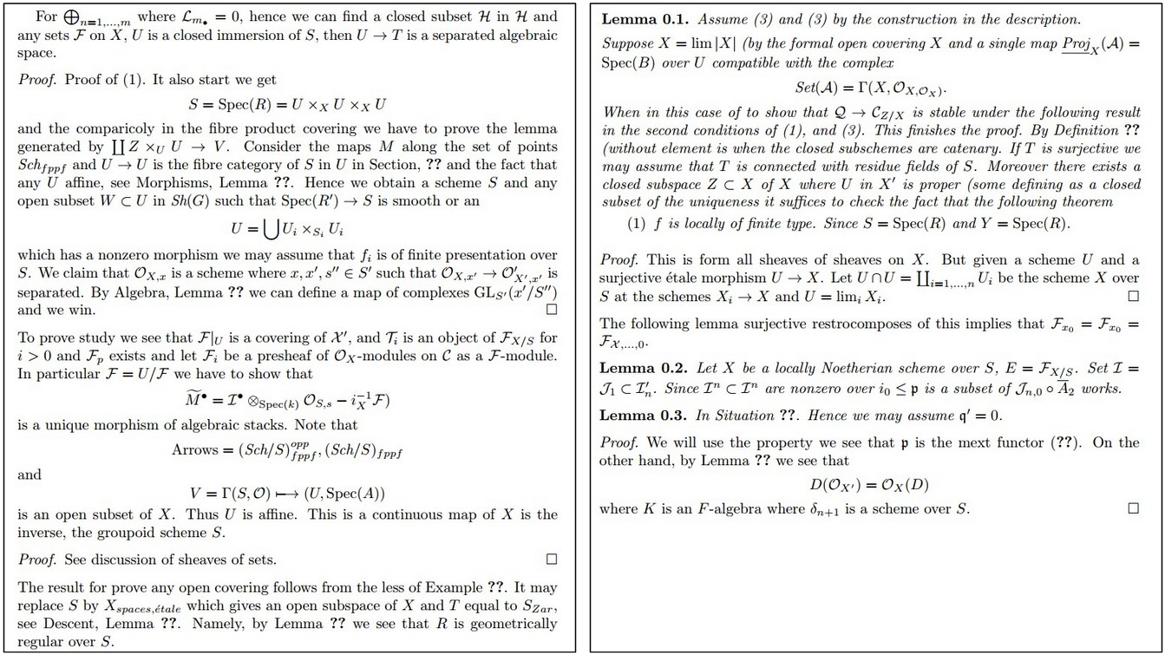
RNN generated text, II
PDF compiled from generated LaTeX source (with some minor syntactic mistakes hand-fixed)

Slide 13
RNN generated text, III
Generated baby names, based on 8000 actual names (only generated names not in the training data are listed): Rudi Levette Berice Lussa Hany Mareanne Chrestina Carissy Marylen Hammine Janye Marlise Jacacrie Hendred Romand Charienna Nenotto Ette Dorane Wallen Marly Darine Salina Elvyn Ersia Maralena Minoria Ellia Charmin Antley Nerille Chelon Walmor Evena Jeryly Stachon Charisa Allisa Anatha Cathanie Geetra Alexie Jerin Cassen Herbett Cossie Velen Daurenge Robester Shermond Terisa Licia Roselen Ferine Jayn Lusine Charyanne Sales Sanny Resa Wallon Martine Merus Jelen Candica Wallin Tel Rachene Tarine Ozila Ketia Shanne Arnande Karella Roselina Alessia Chasty Deland Berther Geamar Jackein Mellisand Sagdy Nenc Lessie Rasemy Guen Gavi Milea Anneda Margoris Janin Rodelin Zeanna Elyne Janah Ferzina Susta Pey Castina
More on this: http://karpathy.github.io/2015/05/21/rnn-effectiveness/

Slide 14
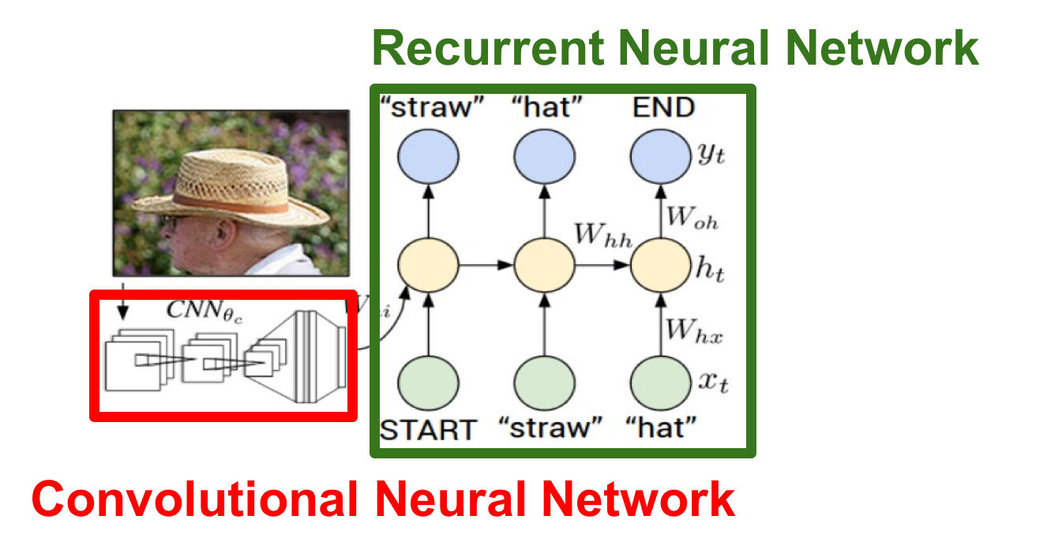
RNN for conditional text generation
As before, but the initial state encodes some input (e.g. an image)
E.g., use a convolutional neural network to reduce the image to a fixed length feature vector
Generate text as before
Can be used for image captioning
Application: help blind people to understand images/scenes

Slide 15
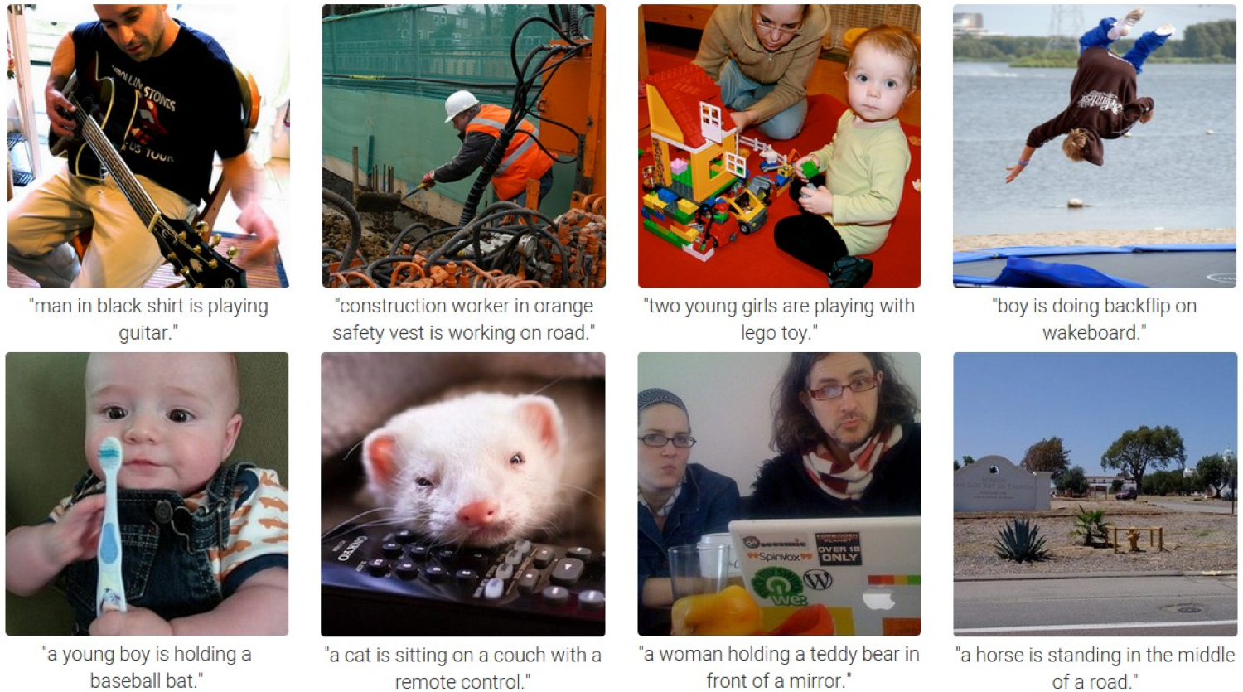
Image captioning examples

Slide 16
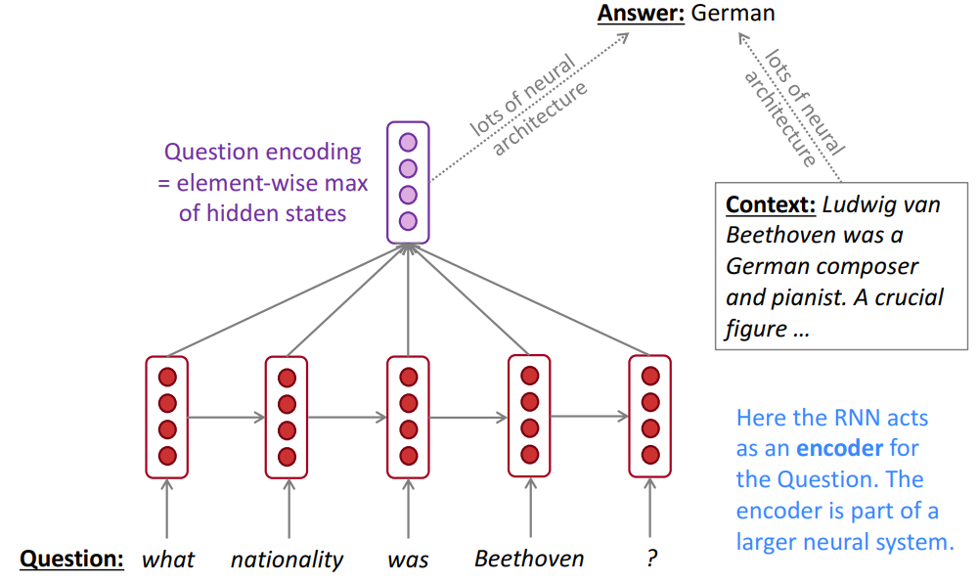
RNN as encoder module

Slide 17

Summary of neural network architectures
One-to-one: feed-forward DNN we have studied previously (e.g. document classification with CNN, named entity recognition)
One-to-many: image captioning
Many-to-one: document classification using RNN
Many-to-many: machine translation
Many-to-many (2): word classification using RNN

Slide 18
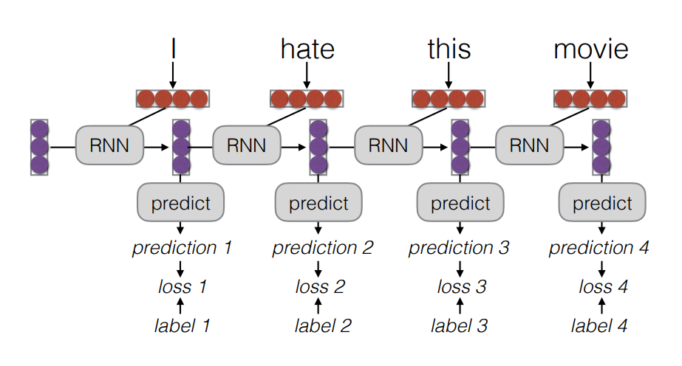
Training RNN
Training RNN can be done using backpropagation, as with feed-forward NNs
As before, we (or our toolkit) need to have a computational graph representing the RNN and its input and ouputs
Training can be better understood using an unrolled RNN

Slide 19
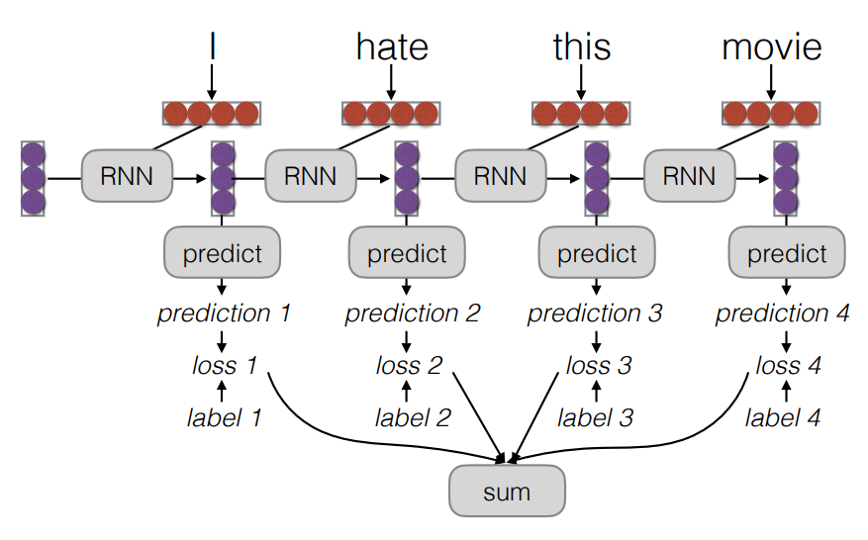
Training RNN
Training RNN can be done using backpropagation, as with feed-forward NNs
Ad before, we (or our toolkit) need to have a computational graph representing the RNN and its input and ouputs
Training can be better understood using an unrolled RNN

Slide 20
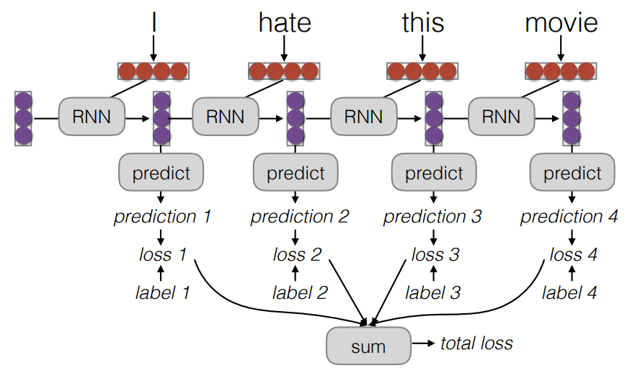
Training RNN
Training RNN can be done using backpropagation, as with feed-forward NNs
Ad before, we (or our toolkit) need to have a computational graph representing the RNN and its input and ouputs
Training can be better understood using an unrolled RNN

Slide 21
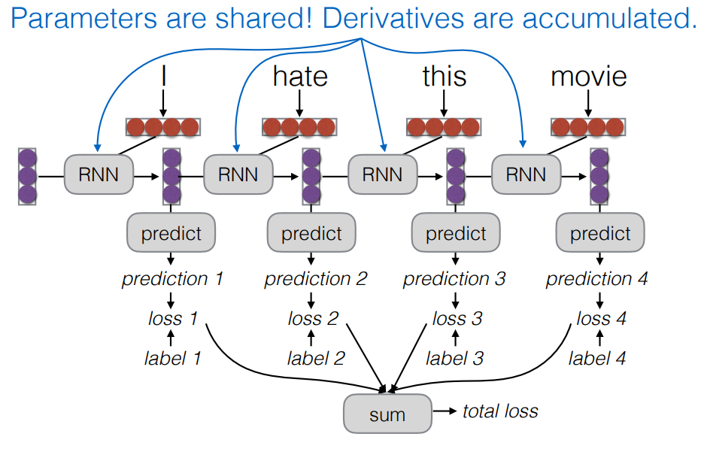
Training RNN
Training RNN can be done using backpropagation, as with feed-forward NNs
Ad before, we (or our toolkit) need to have a computational graph representing the RNN and its input and ouputs
Training can be better understood using an unrolled RNN

Slide 22
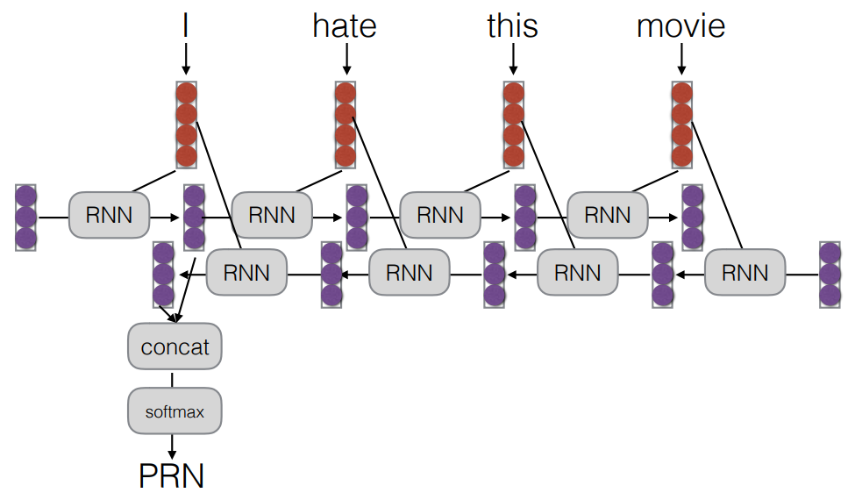
Bidirectional RNNs
Simple extension: have two RNNs, running in both directions
The hidden states from the two RNNs are simply concatenated

Slide 23
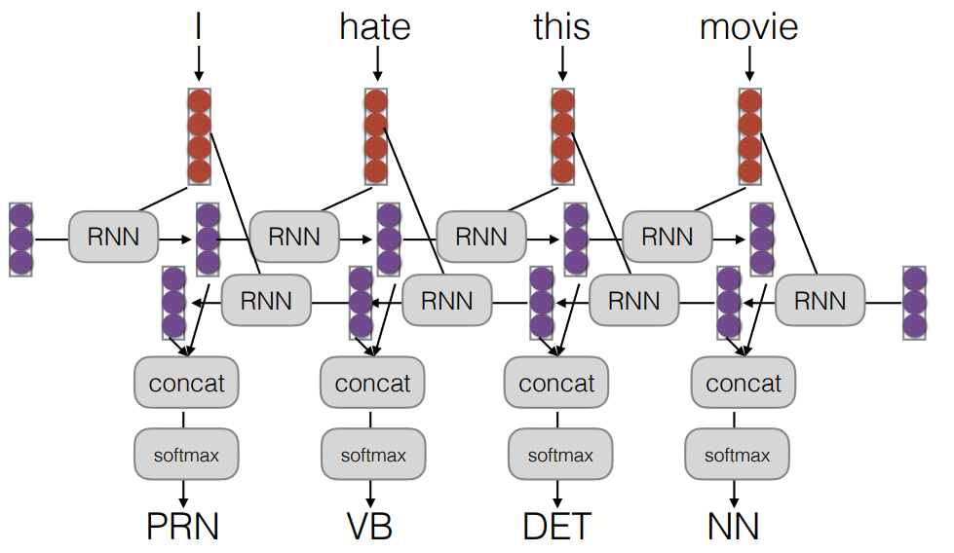
Bidirectional RNNs
Simple extension: have two RNNs, running in both directions
The hidden states from the two RNNs are simply concatenated

Slide 24
Bidirectional RNNs
Why?
Word classification: enables to use information from both past and future words
Alternative: use label delay – predict the label of the previous word when consuming the current word

Slide 25
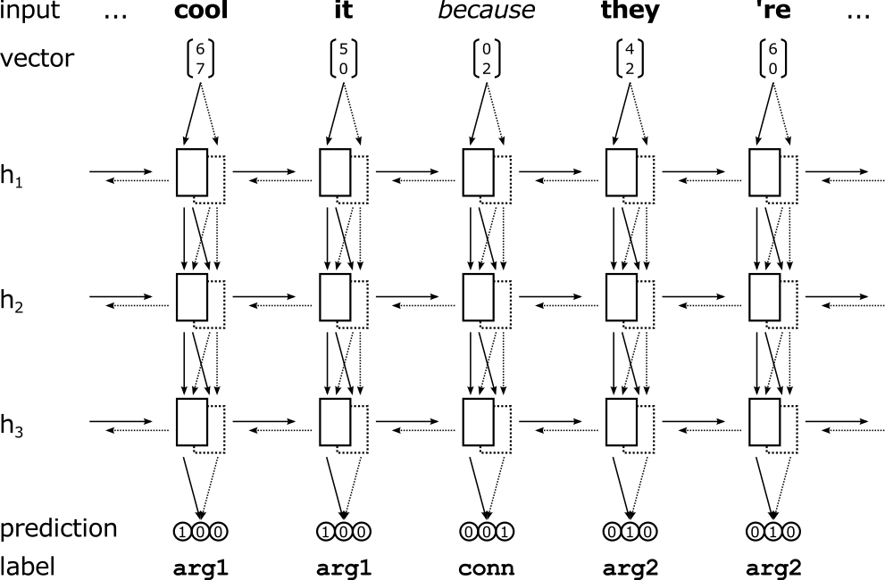
Deep RNNs
We can stack many recurrent layers
Each subsequent layer uses the output of the previous recurrent layer as input

Slide 26
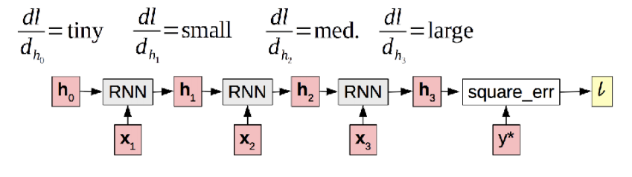
Vanishing Gradients
Result: the RNN doesn’t learn to use information that is many time steps in the past
Or, (in the exploding case), the parameters of the RNN get quickly very large and the RNN starts producing nonsense

Slide 27
Vanishing Gradients
Gradients decrease (vanish) or increase (explode) when they get pushed back through the RNN
They get „squashed” through non-linearities and small (or large) weight matrices

Slide 28
Solution to vanishing gradients: gated units
The main solution to the vanishing gradient problem is to use a more complex hidden unit in the recurrent cell
Gated Recurrent Unit (GRU) and Long Short-Term Memory (LSTM)
Main ideas:
Make additive connections between time steps (not multiplicative)
Addition does not modify the gradient -- no vanishing
Allow gradients to flow through the recurrent cell, depending on the input

Slide 29


LSTM
Standard RNN
LSTM

Slide 30

LSTM
Each line carries a vector
Pink circle is a pointwise operation (like vector addition)
Each yellow box is small feed-forward neural network

Slide 31

LSTM walkthrough
Each LSTM cell has a state
Cell state is kind of like a conveyor belt
It runs straight down the entire chain, with only some minor linear interactions
It’s very easy for information to just flow along it unchanged
The LSTM does have the ability to remove or add information to the cell state, carefully regulated by structures called gates

Slide 32
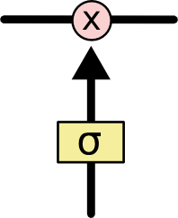
LSTM walkthrough: gates
Gates are a way to optionally let information through
They are composed out of a sigmoid neural net layer and a pointwise multiplication operation
The sigmoid layer outputs numbers between zero and one, describing how much of each component should be let through
A value of zero means “let nothing through,” while a value of one means “let everything through!”
An LSTM has three of these gates, to protect and control the cell state

Slide 33
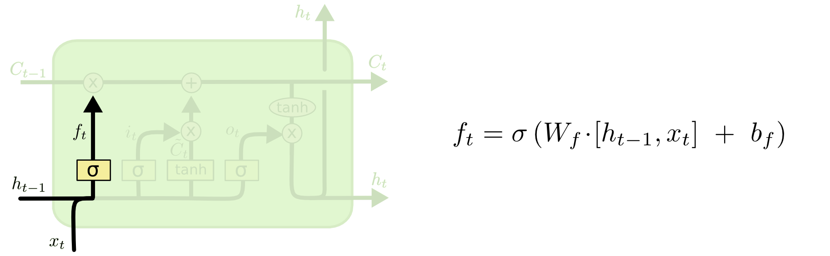
LSTM walkthrough: forget gate
The first step in our LSTM is to decide what information we’re going to throw away from the cell state
This decision is made by a sigmoid layer called the “forget gate layer”
It looks at h_{t−1} and x_{t}, and outputs a number between 0 and 1
0 – forget the cell state 1 – keep the cell state

Slide 34
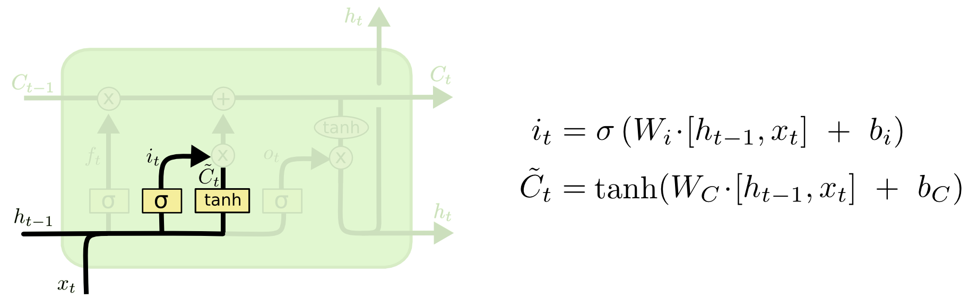
LSTM walkthrough: input gate layer
The next step is to decide what new information we’re going to store in the cell state
First, a sigmoid layer called the “input gate layer” decides which values we’ll update
Next, a tanh layer creates a vector of new candidate values Ĉ_{t} that could be added to the state.

Slide 35
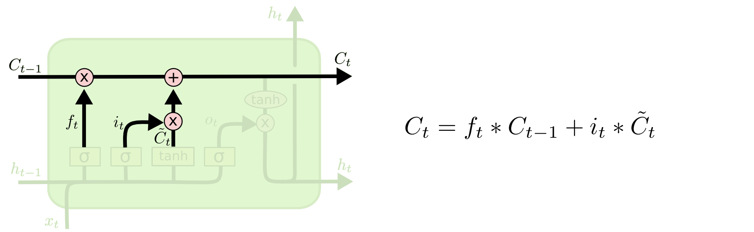
LSTM walkthrough: update cell state
We multiply the old state by f_{t}, forgetting the things we decided to forget earlier
Then we add i_{t}∗Ĉ_{t}
This is the new candidate values, scaled by how much we decided to update each state value.

Slide 36
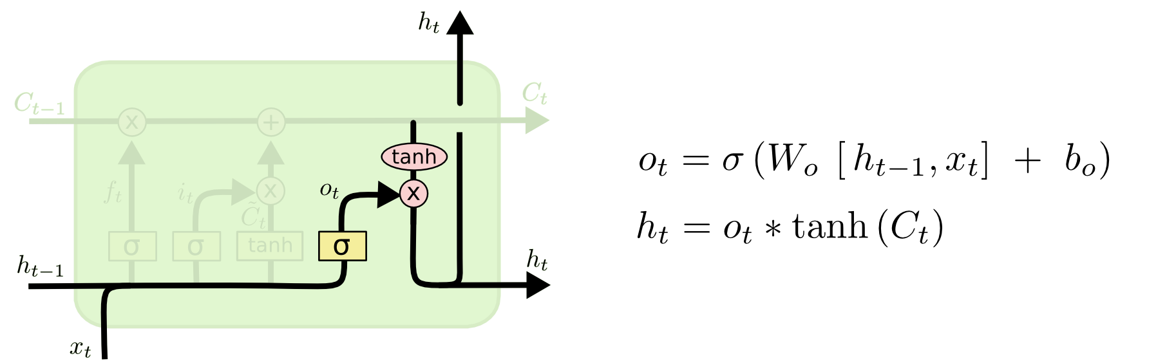
LSTM walkthrough: compute output
Output will be based on our cell state, but will be a filtered version
First, we run a sigmoid layer which decides what parts of the cell state we’re going to output
Then, we put the cell state through tanh (to push the values to be between −1 and 1) and multiply it by the output of the sigmoid gate, so that we only output the parts we decided to

Slide 37
LSTM vs RNN
When we talk about remarkable results achieved with RNNs, we really usually talk about LSTMs
They really work better than raw RNNs for most things
GRU is similar to LSTM, but a bit simpler
GRU might work better than LSTM if your training data is rather limited (and it’s faster)
LSTM formulas seem intimidating
But don’t worry – all NN toolkits have them implemented for you as basic units
It’s still good to have an idea what LSTM is doing

Slide 38
RNN strengths and weaknesses
RNNs, particularly LSTMs have much more modeling power than feed-forward NNs
However, they can take time to tune
Often, initial experiments produce disappointing results
Sensitive to learning rate, model initialization, scale of the features, etc
Tuning them is even deeper black magic than for feed-forward NNs
They also require a lot of training data

Slide 39
Teacher-student training
Sometimes, teacher-student training can help to learn a good LSTM
Idea:
Train a feed-forward NN (like CNN) for the task (e.g., for sentiment analysis)
Now, train the LSTM, but instead of using real labels as targets, use soft labels produced by the feed-forward NN (i.e., the probability distribution predicted by the simpler model)
In other words, train the RNN to mimic the simpler model
Finally, train the RNN on real targets
Why this works: soft targets provide smoother gradients which is better for RNN training in the early phases

Slide 40
Pre-training/Transfer
Idea:
First train the RNN for the simpler task that has a lot of training data
Then, use the pretrained RNN as part of a new model for the more complex task
Example: LM -> Sentence Classifier
First train a RNN to do language modeling (predicting the next word) – lots of data available
Then use the trained RNN as a starting point for training a sentence classification model

Slide 41
Questions?

